Slide 1
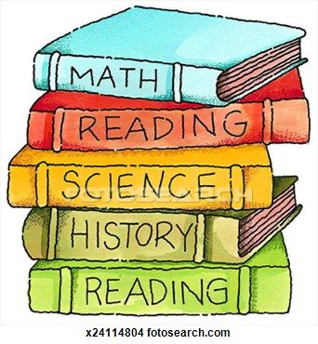
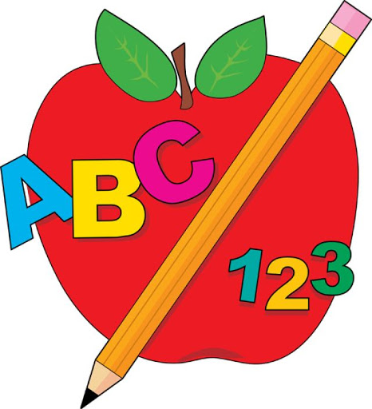
Blue Words

Slide 2
open

Slide 3
which

Slide 4
would

Slide 5
these

Slide 6
best

Slide 7
does

Slide 8
call

Slide 9
been

Slide 10
made

Slide 11
those

Slide 12
right

Slide 13
found

Slide 14
very

Slide 15
because

Slide 16
your

Slide 17
buy

Slide 18
their

Slide 19
why

Slide 20
before

Slide 21
gave

Slide 22
both

Slide 23
always

Slide 24
many

Slide 25
first

